Slide 1

DATABASE DESIGN & ANALYTICS FOR E-COMMERCE
Presented By:
Sweta Kumari
Tanapat Klomjit

Slide 2

Ecommerce Business
E-commerce is undoubtedly not a new trend anymore, but it is now an essential platform that every business needs in order to strive for more growth and future-proof.
Figure 1. Ecommerce. Retrieved from https://www.disruptiveadvertising.com/ppc/ecommerce/ecommerce-business/

Slide 3
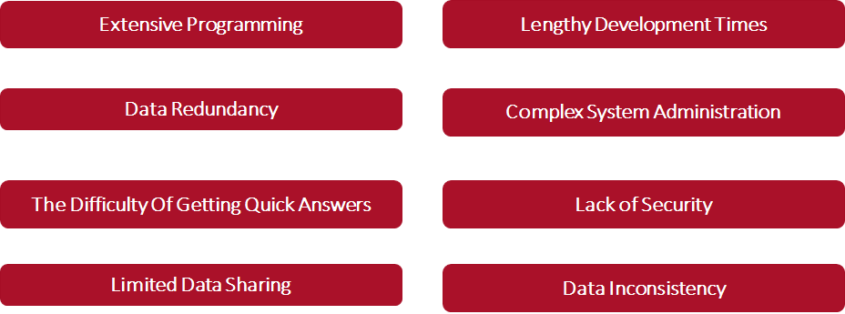
Problems with File Based System

Slide 4
How do we solve problem?
TRANSFORMING
FILE-BASED SYSTEM to RELATIONAL DATABASE

Slide 5

RDBMS Solve E-commerce Business Issue
Data Integrity
Track Transactions
Provide Data Security
Flexibility (Singh, 2019).
Ease Reporting Capabilities
Figure 2.RDBMS. Retrieved from https://www.youtube.com/watch?v=Ef5WpVlRpMg

Slide 6
DB Info & Dataset Description
MySQL at GGU Portal under tklomjit and skumari
Kaggle website: http://www.Kaggle.com/jr2ngb/superstore-data
Dataset contains a retail data of a global superstore for 4 years from 2011 to 2014.
Data contains the information about customer, products, product categories/subcategories, shipping details along with quantity, shipping cost, discount etc.
Data visualization tool: Microsoft Power BI

Slide 7
Step1: Create ER Diagram

Slide 8
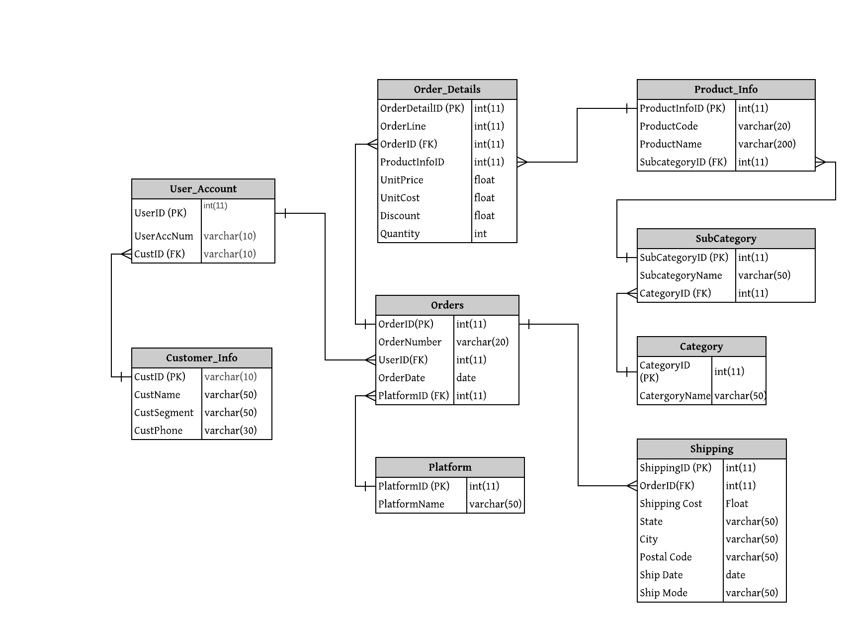
ER Diagram for E-commerce Relational Database

Slide 9
Step2: Create Table

Slide 10


Creating Tables
Customer_Info
User_Account
Platform
Category
SubCategory
Product_Info
Orders
Order_Details
Shipping

Slide 11
Step3: Insert the data into tables

Slide 12
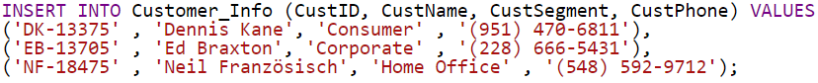
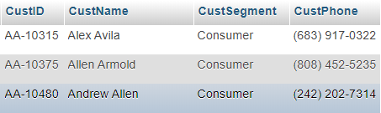
Customer_Info
Number of rows: 793

Slide 13
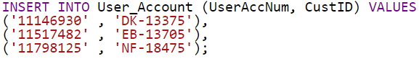
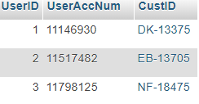
User_Account
Number of rows: 793

Slide 14
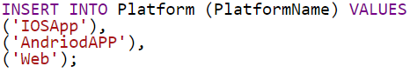
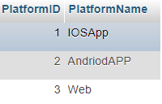
Platform
Number of rows: 3

Slide 15
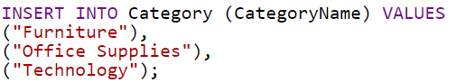
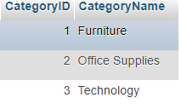
Category
Number of rows: 3

Slide 16
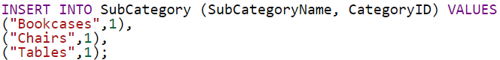
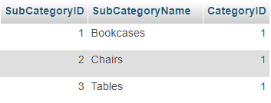
SubCategory
Number of rows: 17

Slide 17
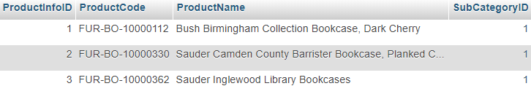
Product_Info
Number of rows: 1842

Slide 18
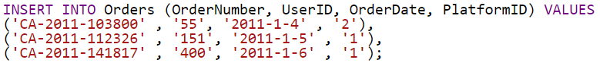
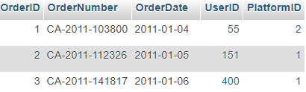
Orders
Number of rows: 5009

Slide 19
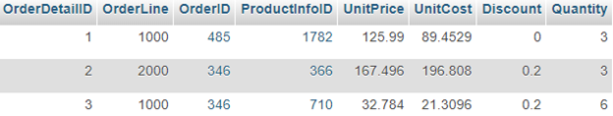
Orders_Details
Number of rows: 9994

Slide 20
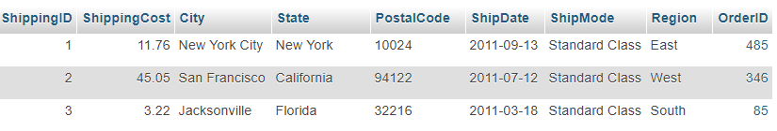
Shipping
Number of rows: 5009

Slide 21
Step4: Analyze the data

Slide 22
Business Questions
What are top-selling and slow products in term of profitability?
What are the top 10 states that have the maximum number of sales?
Find top customers based on profit. What are the sales and number of orders associated with it?
We analyze sales performance for the past 4 years by months and years to see any trend.
There are various platforms for customers to press an order via E-commerce. We analyze different platforms: IOS App, Android App, and web browser.
What are the total profits for each year based on the product category?
Which customer segments are profitable each year? What are the sales numbers for each segment?

Slide 23
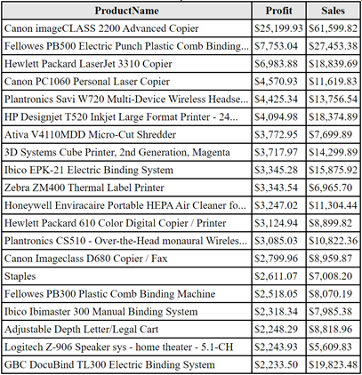
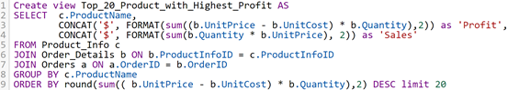
Top 20 Products by Highest Profit
Number of rows: 20

Slide 24
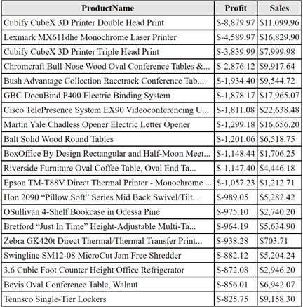
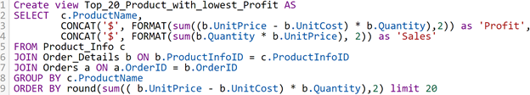
Top 20 Products by Lowest Profit
Number of rows: 20

Slide 25
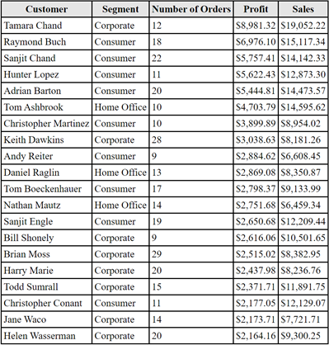
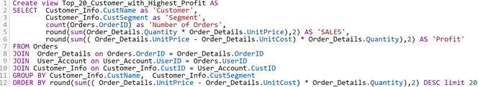
Top 20 Customers by Highest Profit
Number of rows: 20

Slide 26
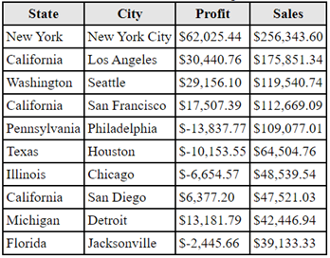
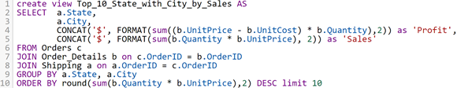
Top 10 State with City by Sales Performance
Number of rows: 10

Slide 27
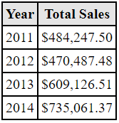
Total Sales By Year
Number of rows: 4

Slide 28
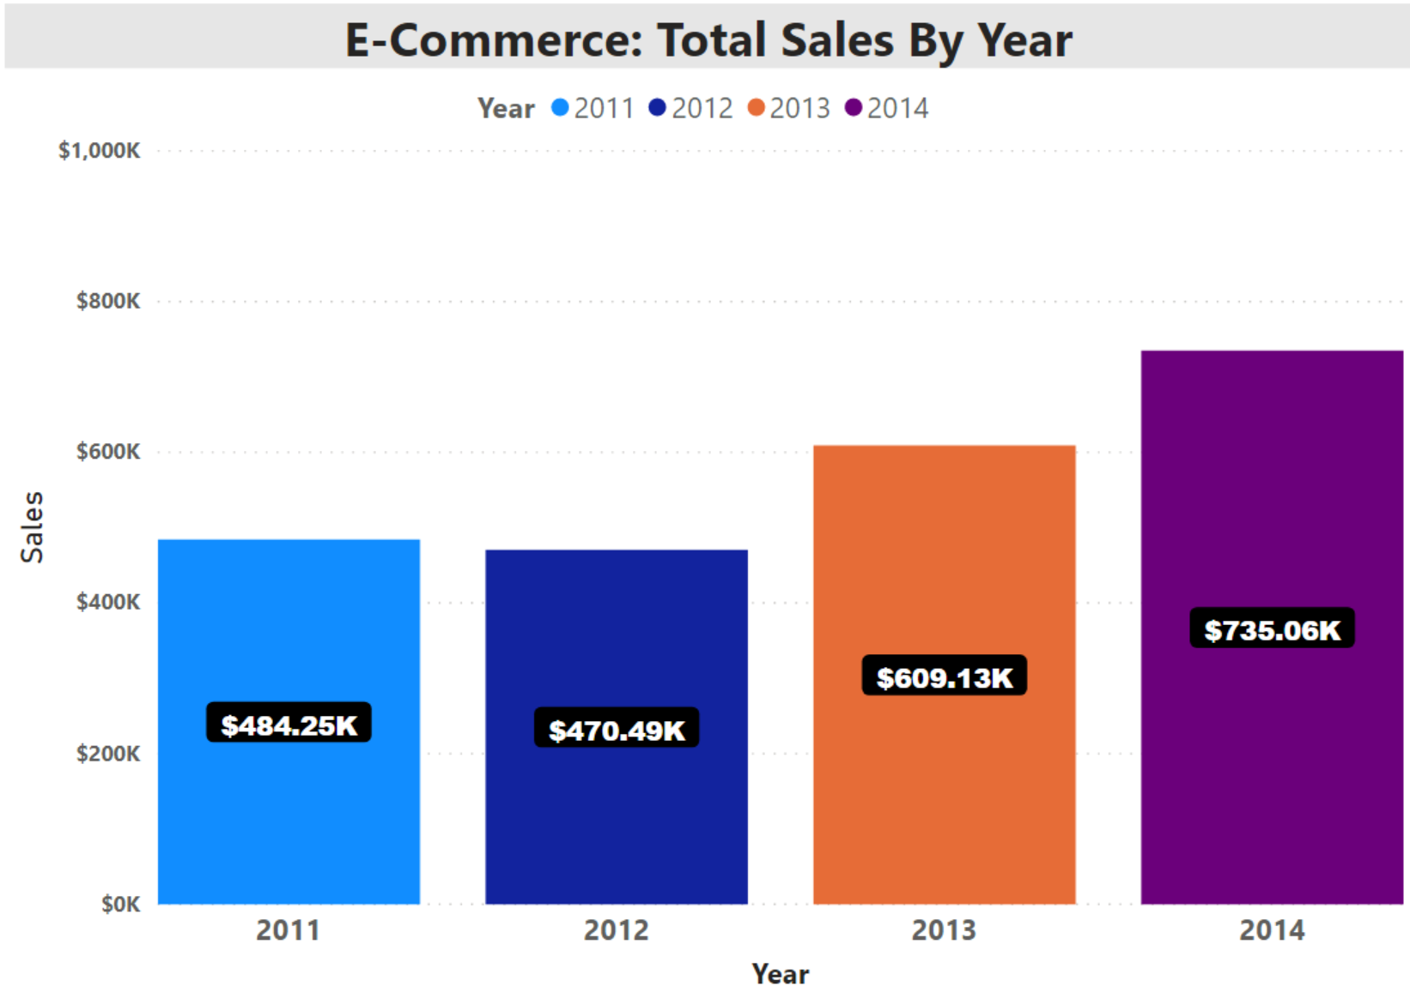
Total Sales By Year

Slide 29
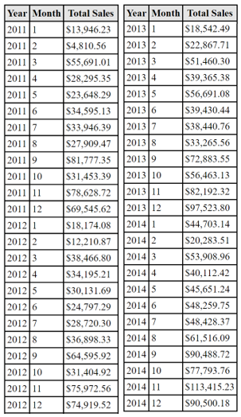
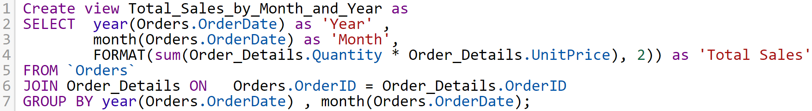
Total Sales By Month and Year
Number of rows: 48

Slide 30
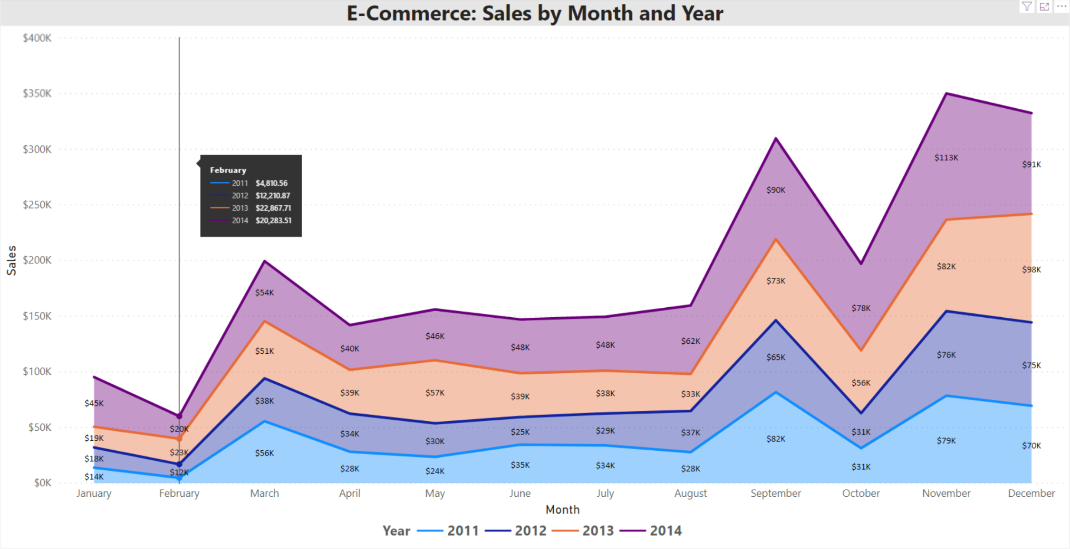
We analyze sales performance for the past 4 years by months and years to see seasonable sales trend when the sale is low during February and peak in November

Slide 31
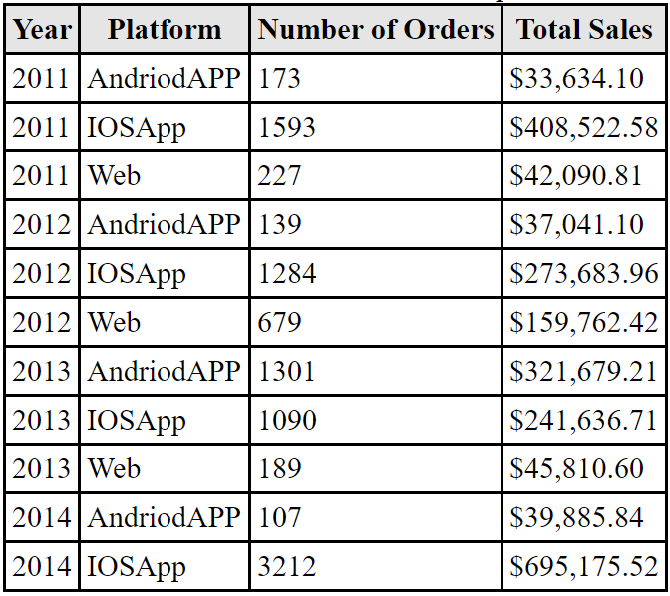
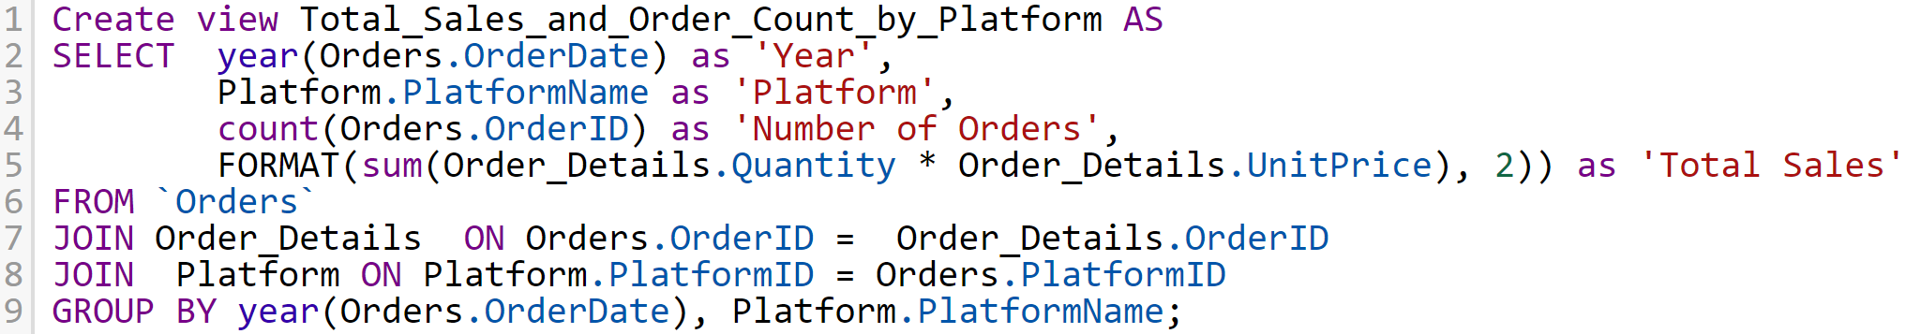
Total Sales and Order Counts by Platforms
Number of rows: 11

Slide 32
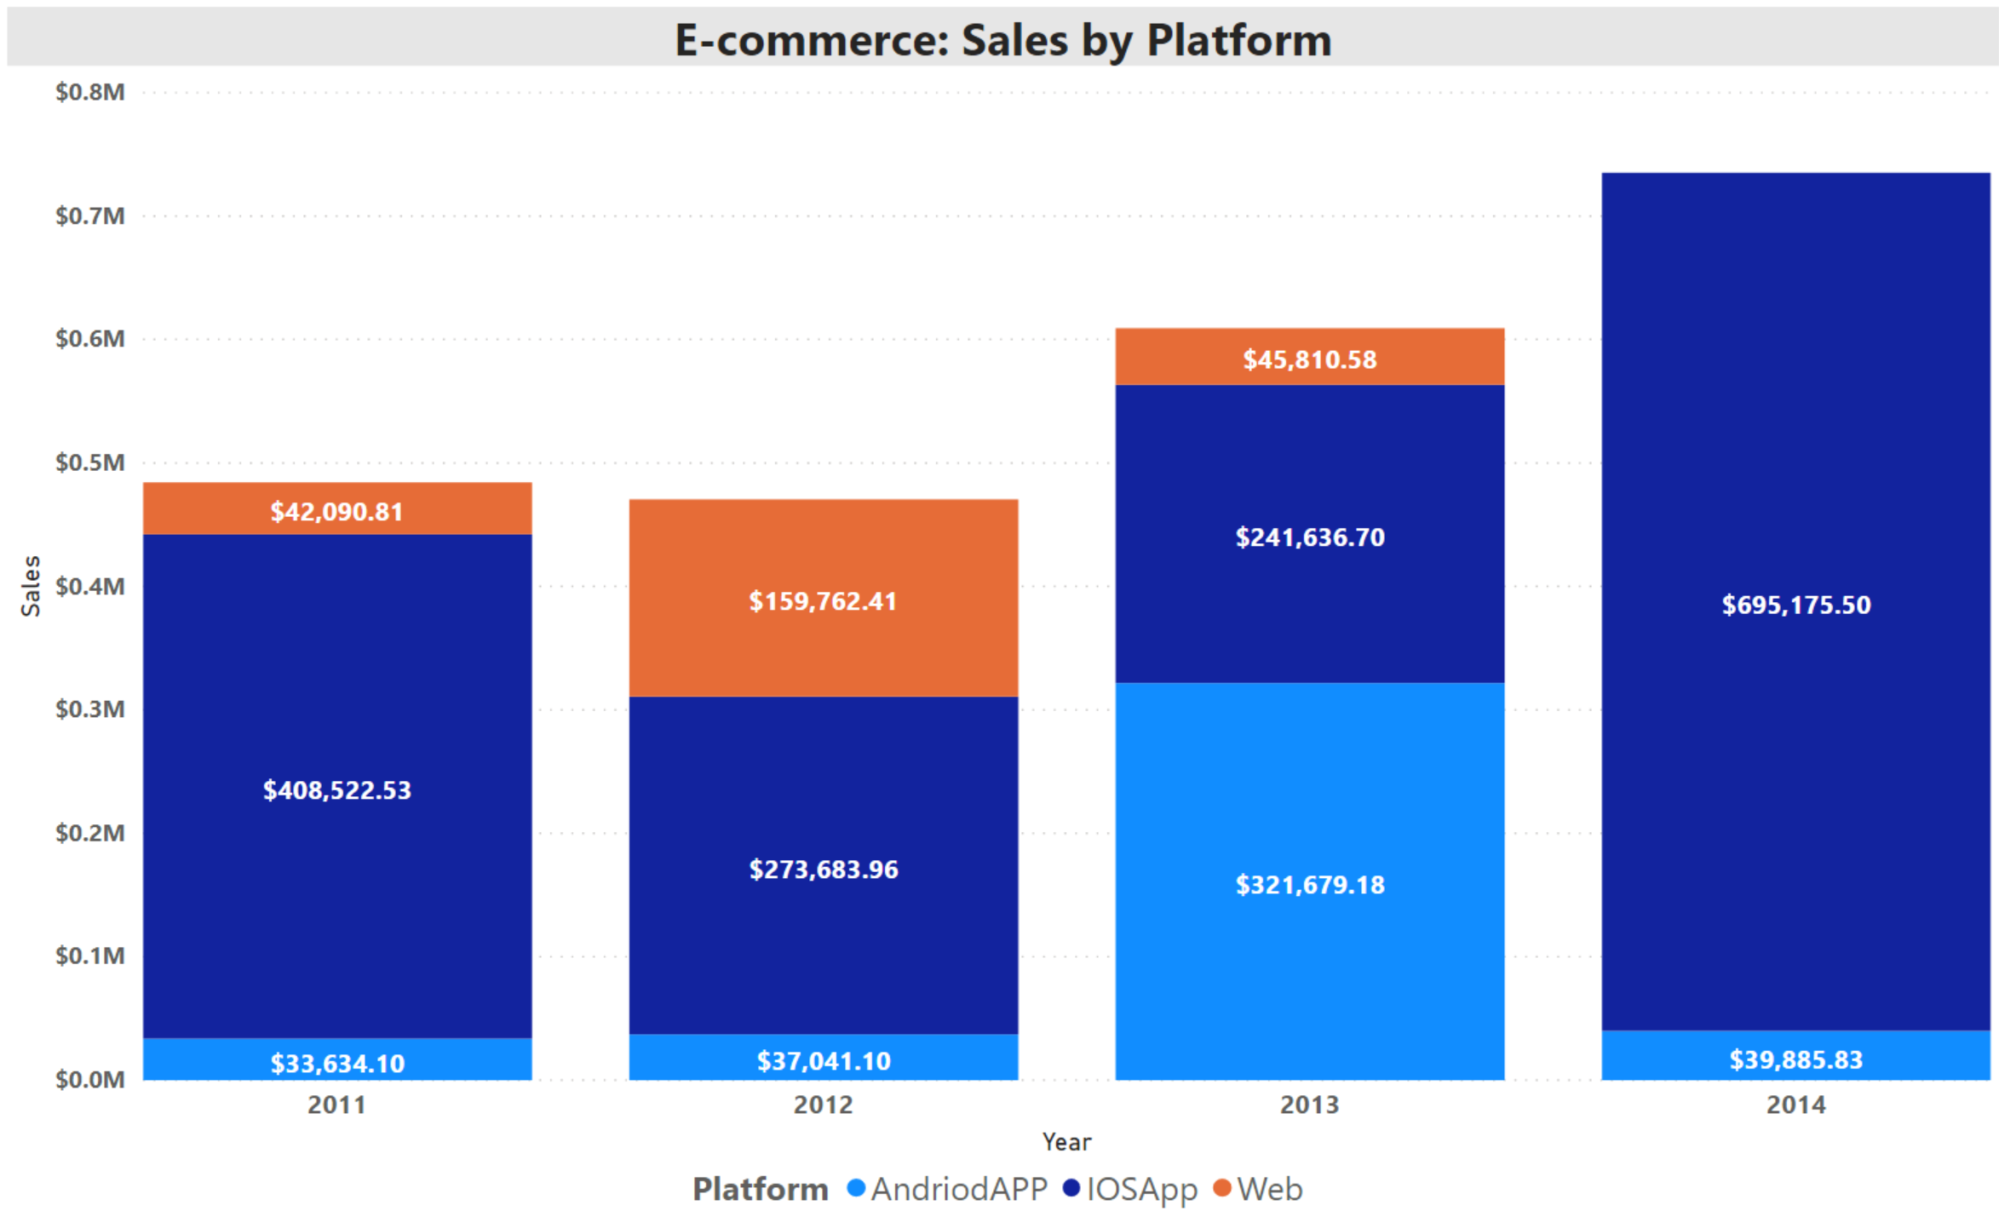
We have no revenue from the Web platform in 2014. The usage of IOSApp is increasing substantially from 2013 to 2014

Slide 33
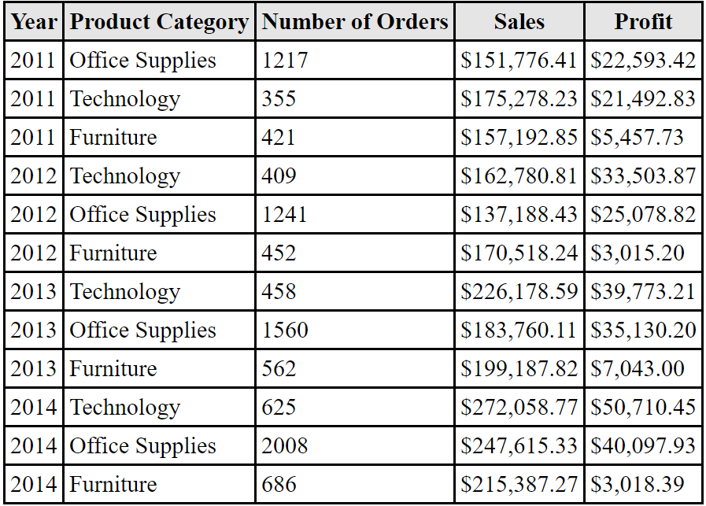
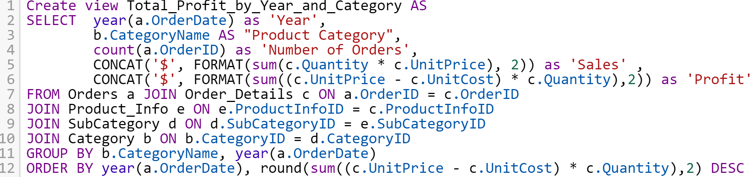
Total Profit By Year and Product Category
Number of rows: 12

Slide 34
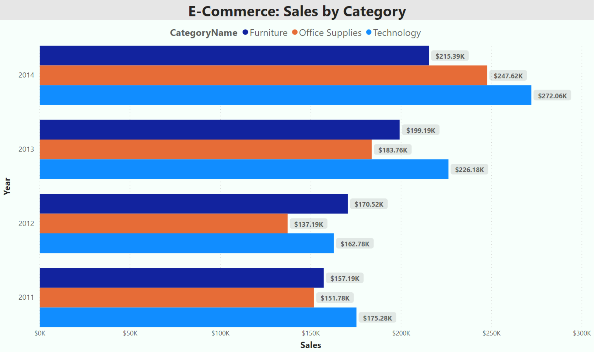
We see that the Furniture has the least profit comparing with other categories
Technology is the most profitable category every year except in 2011

Slide 35
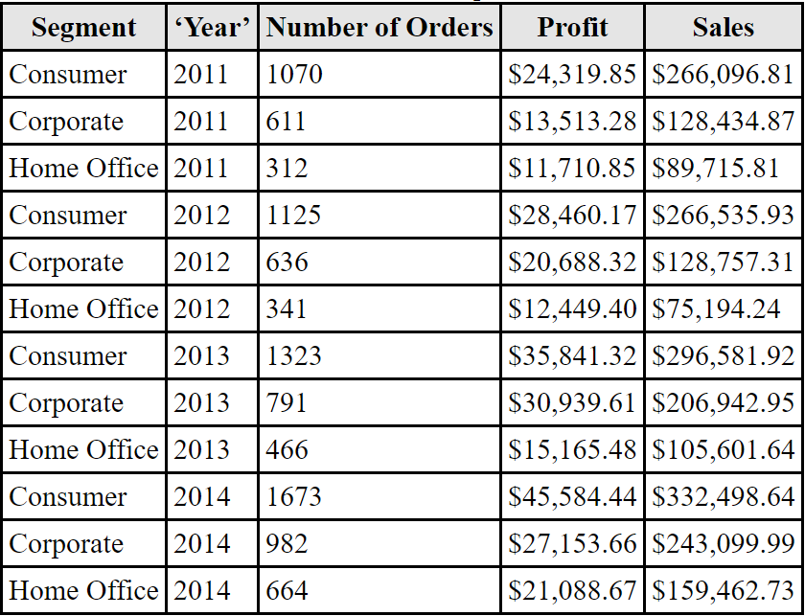
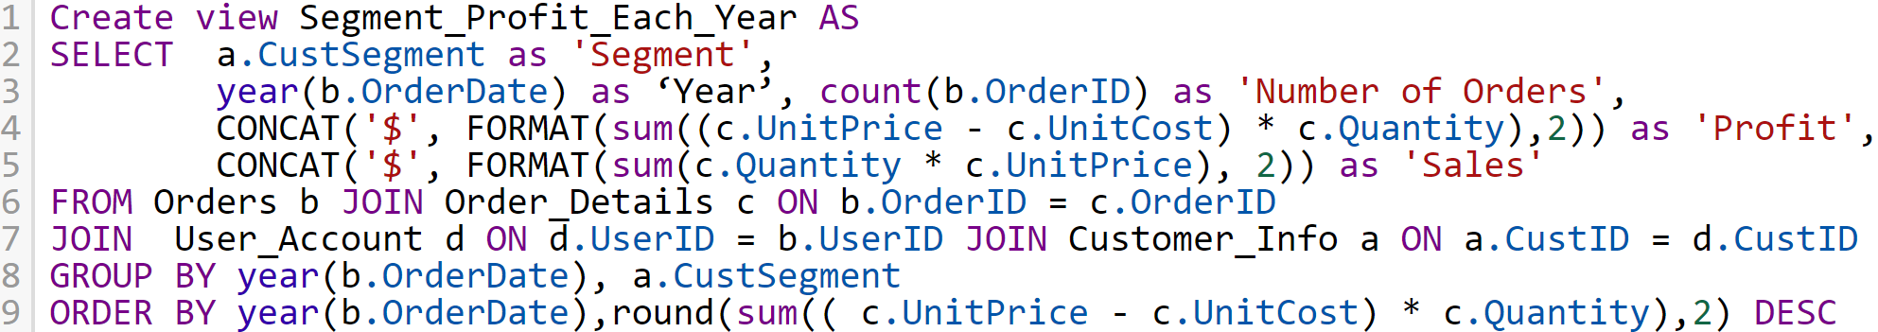
Customer Segment by Highest Profit
Number of rows: 12

Slide 36
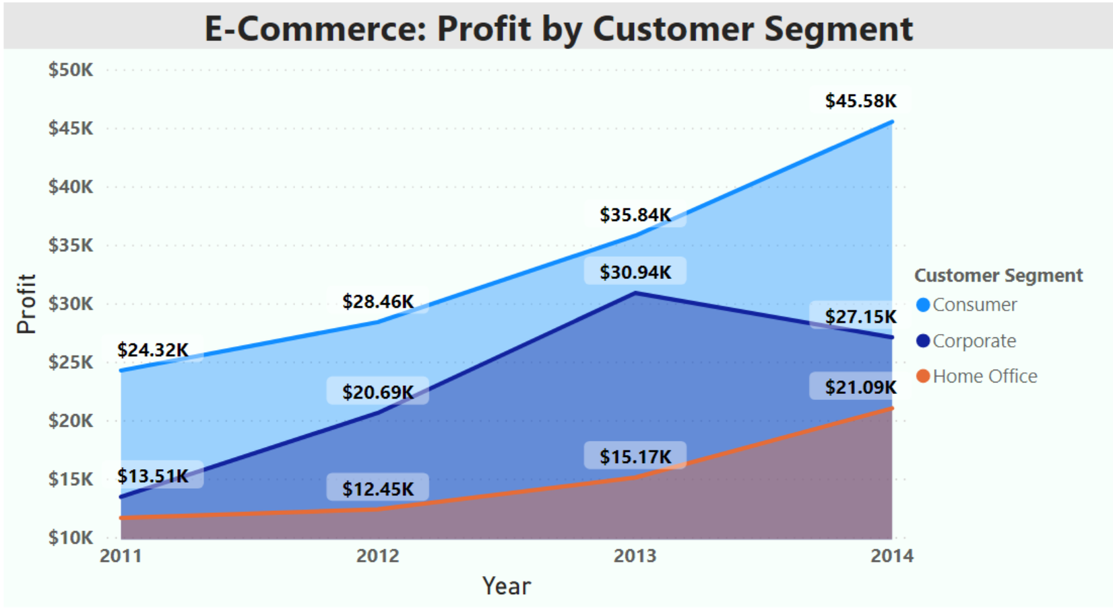
There are various platforms for customers to press an order via E-commerce. We analyze different platforms: IOS App, Android App, and web browser

Slide 37
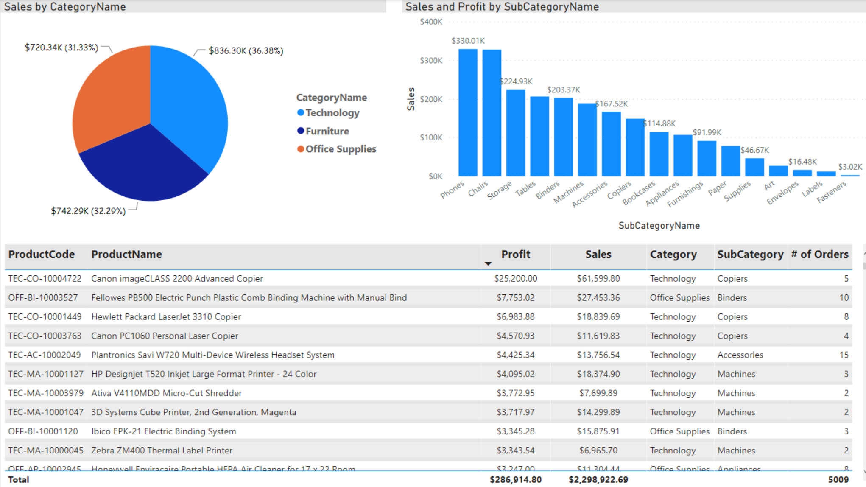
E-Commerce: Dashboard 1.0

Slide 38
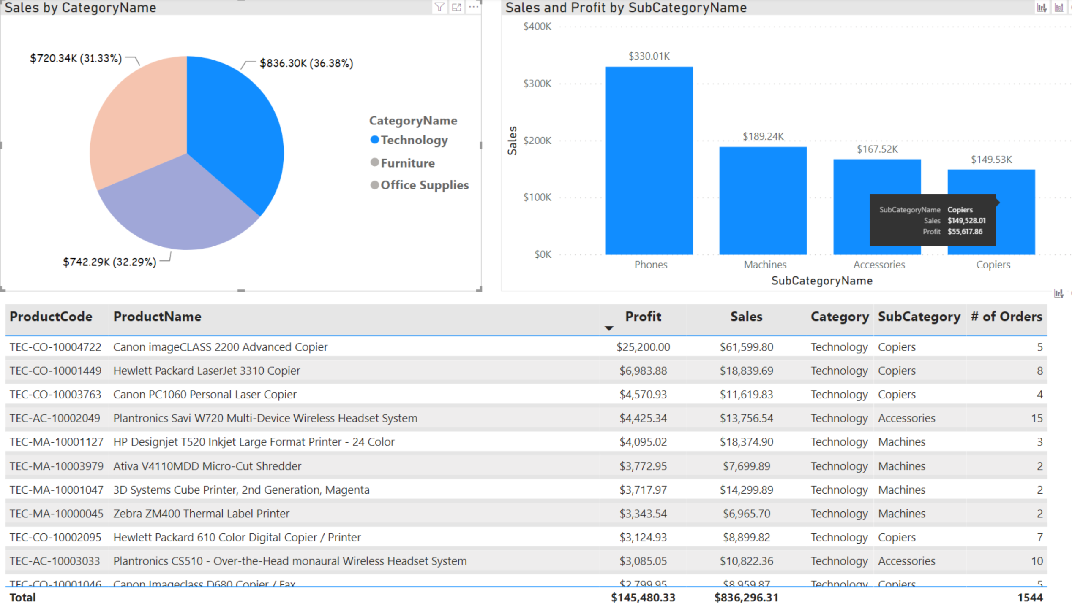
Dashboard 1.1: Selecting Technology Category
The most profitable products (top 3 products) in Technology is in fact under copiers subcategory

Slide 39
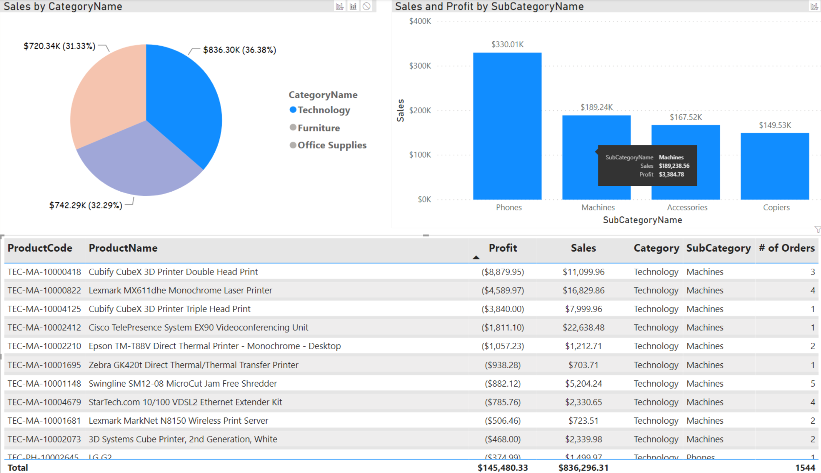
Dashboard 1.2: View the least profitable product in Technology
Our top ten loss (negative net profit) are all from Machines subcategory

Slide 40
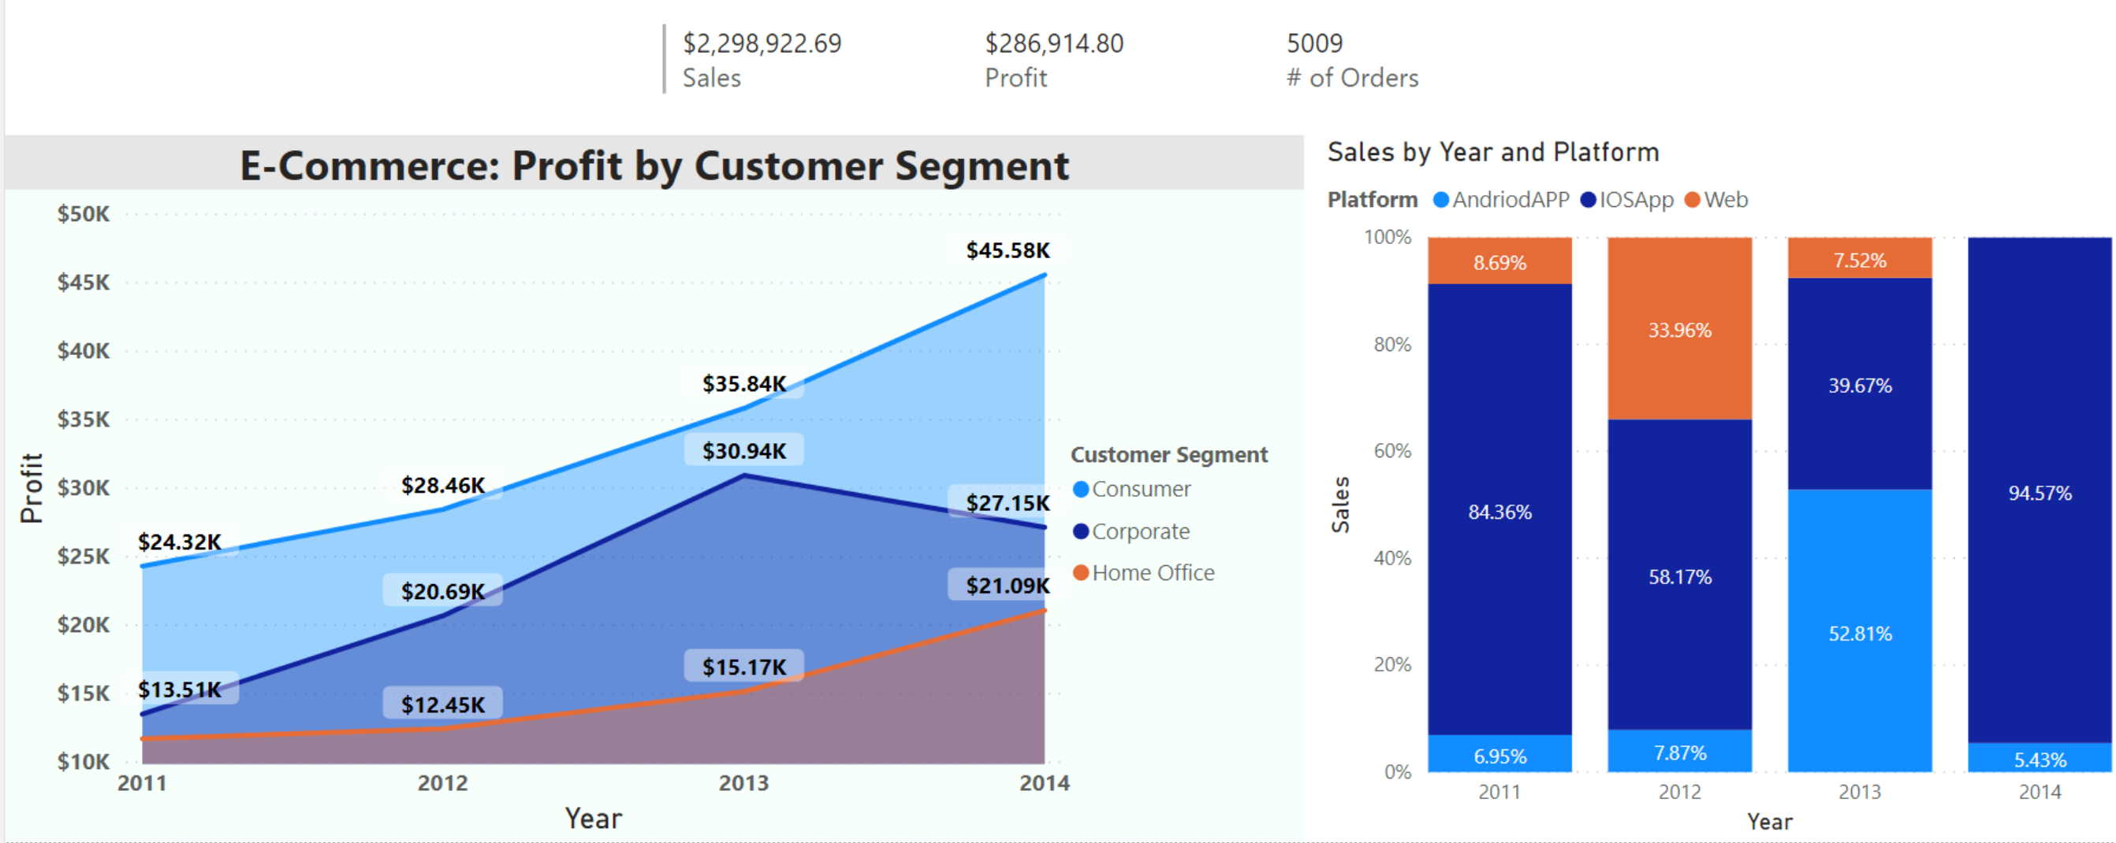
E-Commerce: Dashboard 2.0

Slide 41
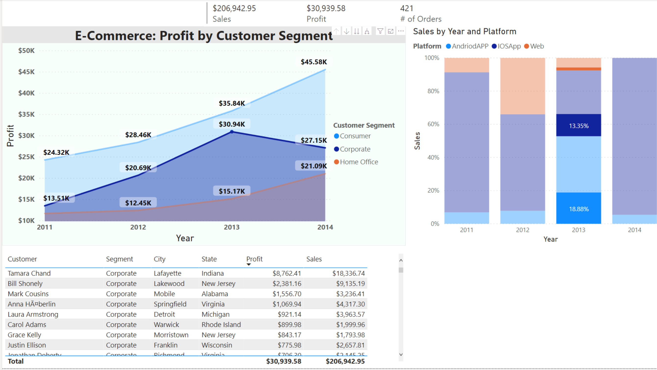
Dashboard 2.1: Drilling down into Corporate in 2013

Slide 42
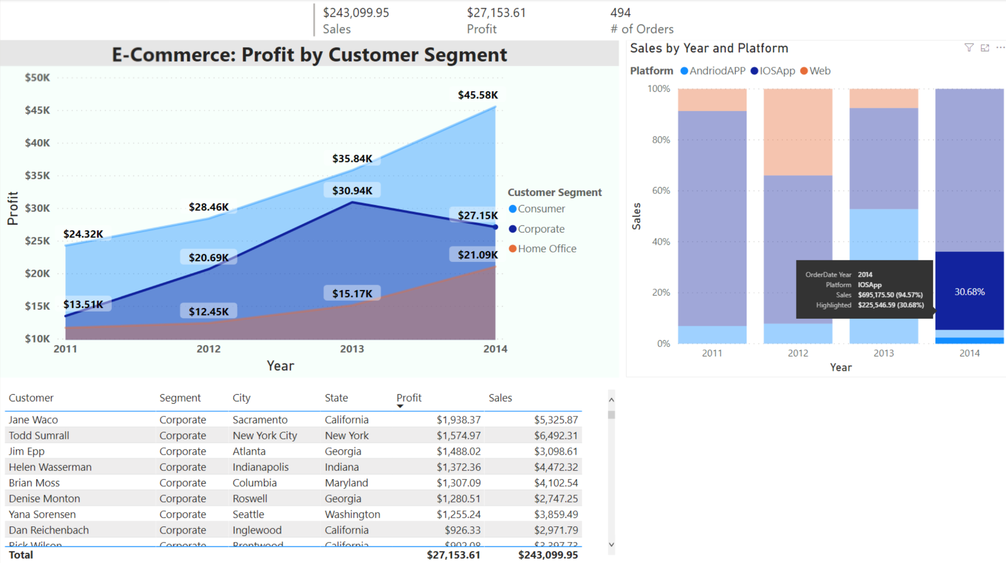
Dashboard 2.1: Drilling down into Corporate in 2014

Slide 43
Conclusions
With RDBMS, we can manage, modify, and maintain our database systematically and easily using SQL
Our database supports the streaming of online transactional data from our E-commerce
The importance of storing quality data, reporting, and data visualization
“Garbage in garbage out”
Dynamic dashboard provides more interactive and drilling down features for business users

Slide 44

LET US KNOW IF YOU HAVE QUESTIONS
OR CLARIFICATIONS

Slide 45
References
Figure 1. Ecommerce. Retrieved from https://www.disruptiveadvertising.com/ppc/ecommerce/ecommerce-business/
Figure 2.RDBMS. Retrieved from https://www.youtube.com/watch?v=Ef5WpVlRpMg
Singh, A. (2017). Role of Database in E-Commerce (With vs Without). Retrieved from https://brandlitic.com/role-of-database-in-ecommerce/

